Slide 1

Topic: Area of Rectangles/ Squares/Composite shapes
EQ: How can we find the area of rectangles and squares?
Mrs. McLeod

Slide 2
Perimeter Warm Up Questions
Find the perimeter of these shapes
4 cm
12 m
7 cm
10 m
8 m
30 m
4 cm

Slide 3

Explain how each group of shapes is different and how they are alike
They are all rectangles: squares are a special type of rectangle that have one more rule that ALL sides are equal
Notes:
Looking for:
All 90 degree angles
Opposite sides parallel
Opposite sides equal (rectangles)
All sides equal (squares)

Slide 4
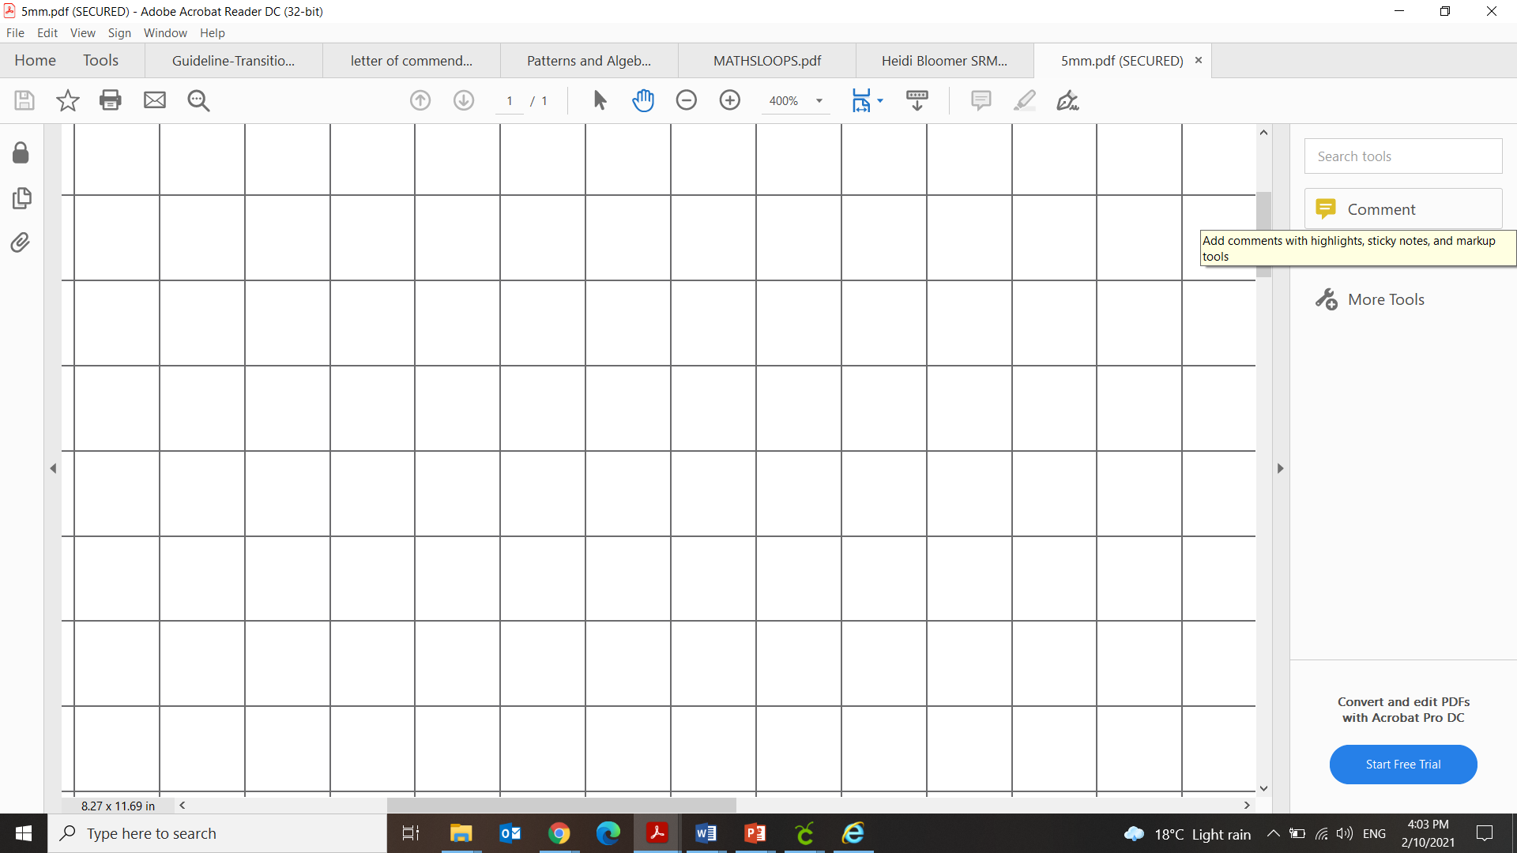
24
7
30
Topic: Area
Date
EQ: How can we find the area of rectangles/squares/composite shapes?
When calculating perimeter we counted the length of the distance AROUND the shape
What is area?
The amount of space inside a flat shape.
We measure area in ‘square’ units
cm² , m² , km²
How many squares inside this shape?
We can’t always count up the squares, and most of the time the squares are not drawn
How can we find the area of a square?
Consider this square. It has a length of 3 cm.
It contains 3 rows of 3 squares.
The area of the square would be 3 cm x 3 cm = 9cm²

Slide 5
24
7
30
Topic: Area
Date
EQ: How can we find the area of rectangles/squares/composite shapes?
We can’t always count up the squares, and most of the time the squares are not drawn
How can we find the area of a square?
Consider this square. It has a length of 3 cm.
It contains 3 rows of 3 squares.
The area of the square would be 3 cm x 3 cm = 9cm²
How would a mathematician write this?
Find the area of a square with a side length 5cm
Area of a square = length × length
Or A = L × L
Or A = L²

Slide 6

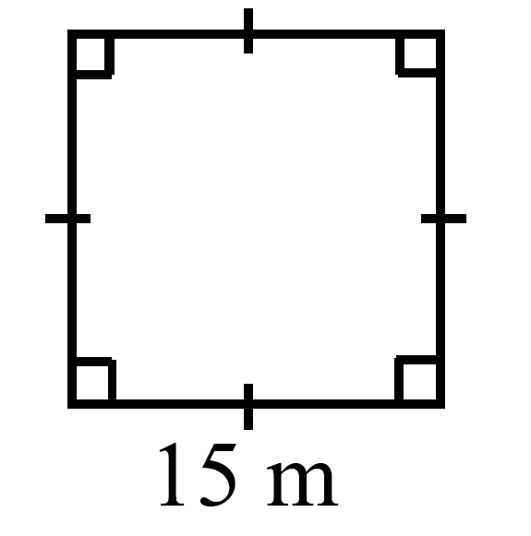
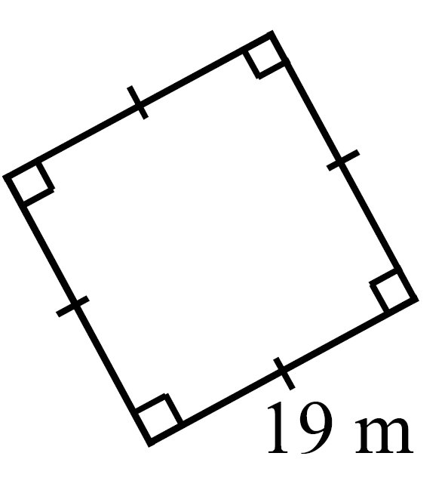
Practice

Slide 7
24
7
30
Topic: Area
Date
EQ: How can we find the area of rectangles/squares/composite shapes?
How can we find the area of a rectangle?
Consider this rectangle. It has a length of 6 cm and a width of 3 cm
It contains 3 rows of 6 squares.
The area of the rectangle would be 3 cm x 6 cm = 18 cm²
How would a mathematician write this?
Area of a rectangle = length × width
Or A = L × W

Slide 8
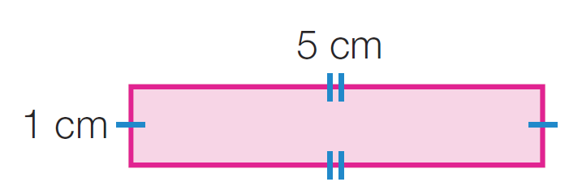
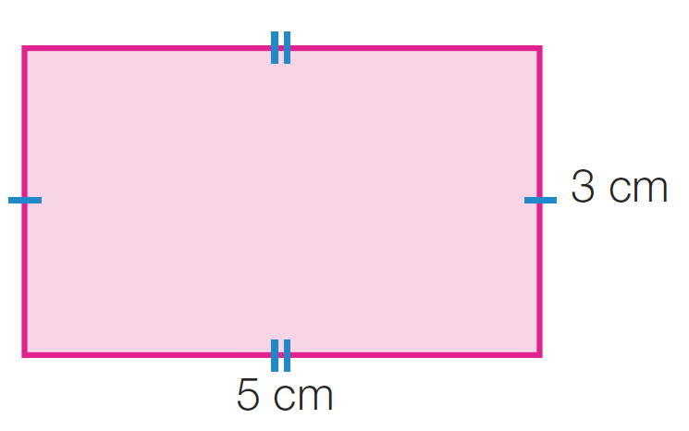
Practice

Slide 9
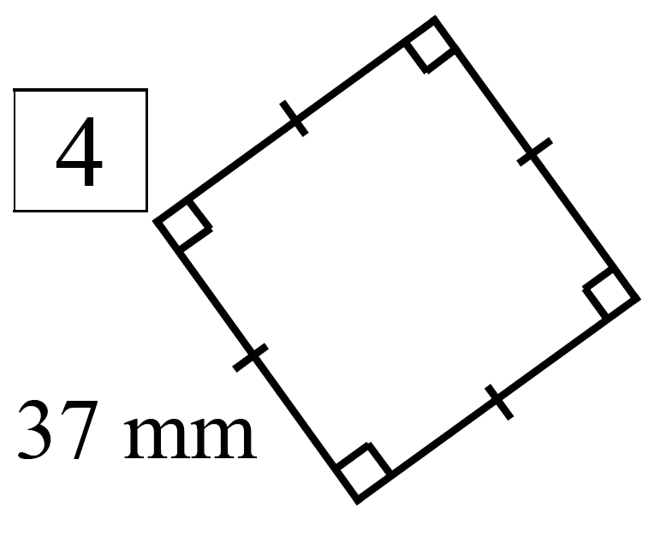
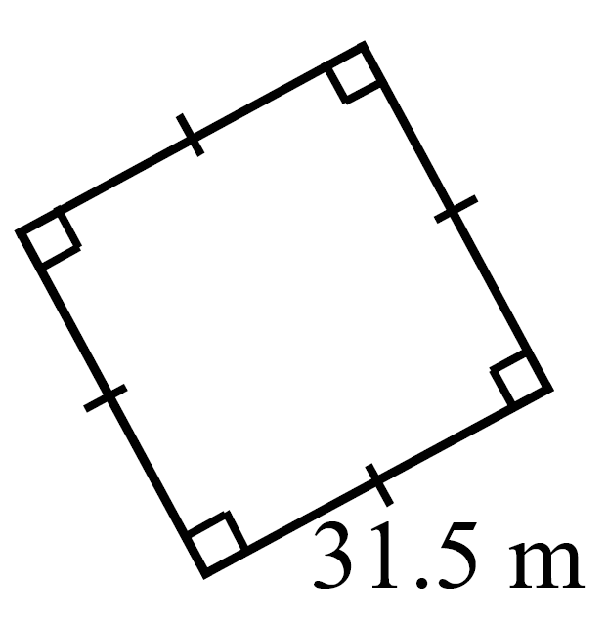
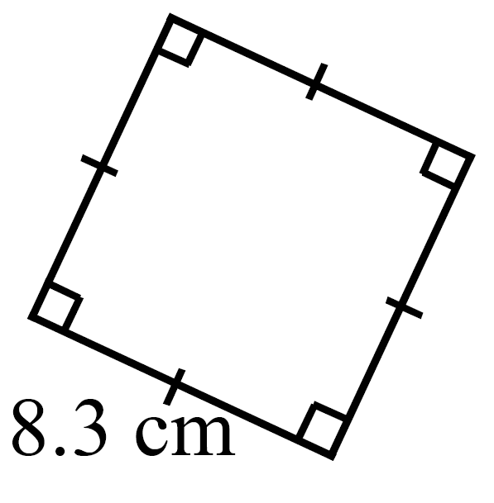
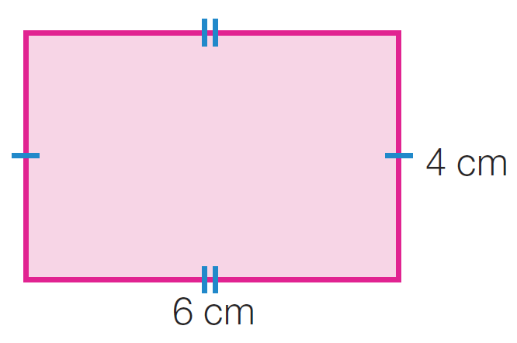
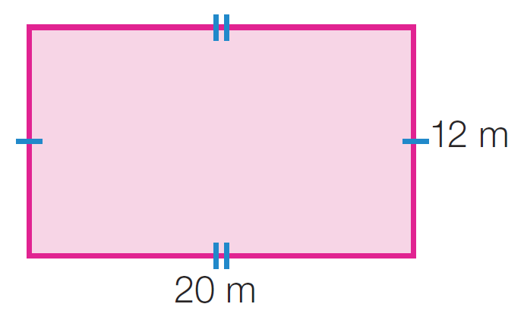
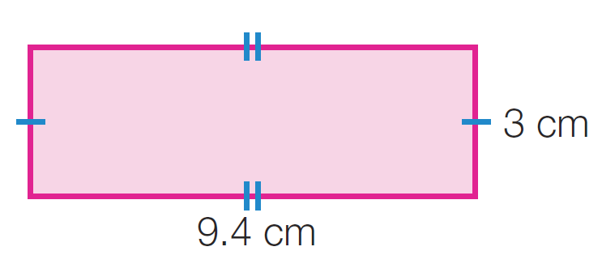
Practice

Slide 10
What do we do if the shape isn’t just a rectangle or a square?

Slide 11
24
7
30
Topic: Area
Date
EQ: How can we find the area of rectangles/squares/composite shapes?
What is a compound shape?
A shape made up of other shapes
How can we find the area?
1. Split the shape into shapes we can easily find the area of (label these with letters)
2. Find each individual area
3. Add together to find the total shapes area
A
B

Slide 12
Let’s try together!
Use the activity sheet to follow along and solve as we do some together!
Notes:
Print off activity sheet (compound area)

Slide 13
Compound Area
Calculate the area of this compound shape:
3cm
6cm
7cm
4cm

Slide 14
Compound Area
Calculate the area of this compound shape:
3cm
6cm
7cm
4cm
Area = (4cm x 6cm) + (3cm x 7cm) =
24cm² + 21cm² =
45cm²

Slide 15
Compound Area
Calculate the area of this compound shape:
3cm
6cm
8cm
2cm
Area = (2cm x 8cm) + (3cm x 6cm) =
16cm² + 18cm² =
34 cm²

Slide 16
Compound Area
Calculate the area of this compound shape:
5cm
10cm
5cm
4cm
Area = (4cm x 10cm) + (5cm x 5cm) =
40cm² + 25cm² =
65cm²

Slide 17
Compound Area
Calculate the area of this compound shape:
3cm
7cm
8cm
6cm
Area = (8cm x 3cm) + (7cm x 6cm) =
24cm² + 42cm² =
66cm²

Slide 18
Compound Area
Calculate the area of this compound shape:
9cm
15cm
7cm
6cm
Area = (7cm x 9cm) + (15cm x 6cm) =
63cm² + 90cm² =
153cm²

Slide 19
Compound Area
Calculate the area of this compound shape:
16cm
4cm
5cm
13cm
Area = (16cm x 4cm) + (13cm x 5cm) =
64cm² + 65cm² =
129cm²

Slide 20
Compound Area
Calculate the area of this compound shape:
32cm
6cm
20cm
24cm
Area = (6cm x 32cm) + (20cm x 24cm) =
192cm² + 480cm² =
672cm²

